Slide 1


Leadership
ORGB1500 - Organizational Behaviour for Media and IT - Ed Beerwart

Slide 2

Leadership
Content
Leadership
Leadership Theories
Eight Leadership Competencies/Traits
Transactional vs. Transformational Leadership

Slide 3
Leadership

Slide 4
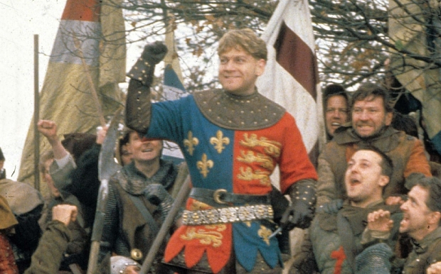
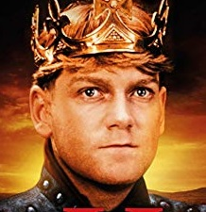
Leadership example
Ap
Henry V
“St. Crispin’s Day Speech”
(6 mins)
Henry V is a history play by William Shakespeare, believed to have been written around 1599. It tells the story of King Henry V of England, focusing on events immediately before and after the Battle of Agincourt (1415) during the Hundred Years' War.
https://vimeo.com/217465105
King Henry
V

Slide 5
Leadership
R
U
“
The processes involved in leading others, including organizing, directing, coordinating, and motivating their efforts toward achievement of certain group or organizational goals.
”
VandenBos, G. R. (Ed.). (2007). APA Dictionary of Psychology. Washington, DC, US: American Psychological Association.

Slide 6
Leadership Theories
R
U
“
Theories advanced to explain the effectiveness or ineffectiveness of leaders.
”
VandenBos, G. R. (Ed.). (2007). APA Dictionary of Psychology. Washington, DC, US: American Psychological Association.

Slide 7
Leadership Theories
R
U
“
The main types of leadership theories include:
Trait Theories of Leadership, which focus on such characteristics as supervisory ability, intelligence, self-assurance, and decisiveness.
Behavioral theories of leadership, which focus on the task-based and relationship-based activities of the leader.
Contingency Theories of leadership, which attempt to describe what type of leadership style is most effective in different situations
”
VandenBos, G. R. (Ed.). (2007). APA Dictionary of Psychology. Washington, DC, US: American Psychological Association.

Slide 8

Leadership
Ap
List 25 famous (or infamous) leaders, either past or present and historical or fictional.
Do they fit into the leadership definition?

Slide 9
Leadership Competencies/Traits

Slide 10
Competence
R
U
“
One’s developed repertoire of skills, especially as it is applied to a task or set of tasks.
A distinction is sometimes made between competence and performance, which is the extent to which competence is realized in one’s actual work on a problem or set of problems.
”
VandenBos, G. R. (Ed.). (2007). APA Dictionary of Psychology. Washington, DC, US: American Psychological Association.

Slide 11
Eight Leadership Competencies
R
U
Personality
- extroversion, conscientiousness
Self-concept
- positive self-evaluation, high self-esteem and self-efficacy, internal locus of control
Drive
- inner motivation to pursue goals, inquisitiveness, action- oriented
Integrity
- truthfulness, consistency in words and actions
“
”
VandenBos, G. R. (Ed.). (2007). APA Dictionary of Psychology. Washington, DC, US: American Psychological Association.

Slide 12
Eight Leadership Competencies
R
U
Leadership Motivation
- high need for socialized power to achieve organizational goals
Knowledge of the Business
- understands external environment, aids intuitive decision making
Cognitive/practical Intelligence
- above average cognitive ability, able to solve real-world problems
Emotional Intelligence
- perceiving, assimilating, understanding, and regulating emotions
“
”
VandenBos, G. R. (Ed.). (2007). APA Dictionary of Psychology. Washington, DC, US: American Psychological Association.

Slide 13
Leadership Competencies/Traits
Ap
Pick three diverse leaders from the previous list. Which leadership competencies do each possess?
If one leader was missing a competenc were they still successful? Why?

Slide 14
Transactional vs. Transformational Leaders

Slide 15
Transactional Leadership
R
U
“
A style of leadership in which the emphasis is on ensuring followers accomplish tasks. Transactional leaders influence others through exchange relationships in which benefits are promised in return for compliance
”
VandenBos, G. R. (Ed.). (2007). APA Dictionary of Psychology. Washington, DC, US: American Psychological Association.

Slide 16
Transformational Leadership
R
U
“
A charismatic, inspiring style of leading others that usually involved heightening followers motivation, confidence, and satisfaction, uniting them in the pursuit of shared, challenging goals, and changing their beliefs, values and needs.
”
VandenBos, G. R. (Ed.). (2007). APA Dictionary of Psychology. Washington, DC, US: American Psychological Association.

Slide 17
Transactional vs Transformational Leadership
Would you consider King Henry V a transactional or transformational leader?
Why or why not?
King Henry
V

Slide 18

Thank You
ebeerwart@nait.ca

